Slide 1

Data Visualisation

Slide 2
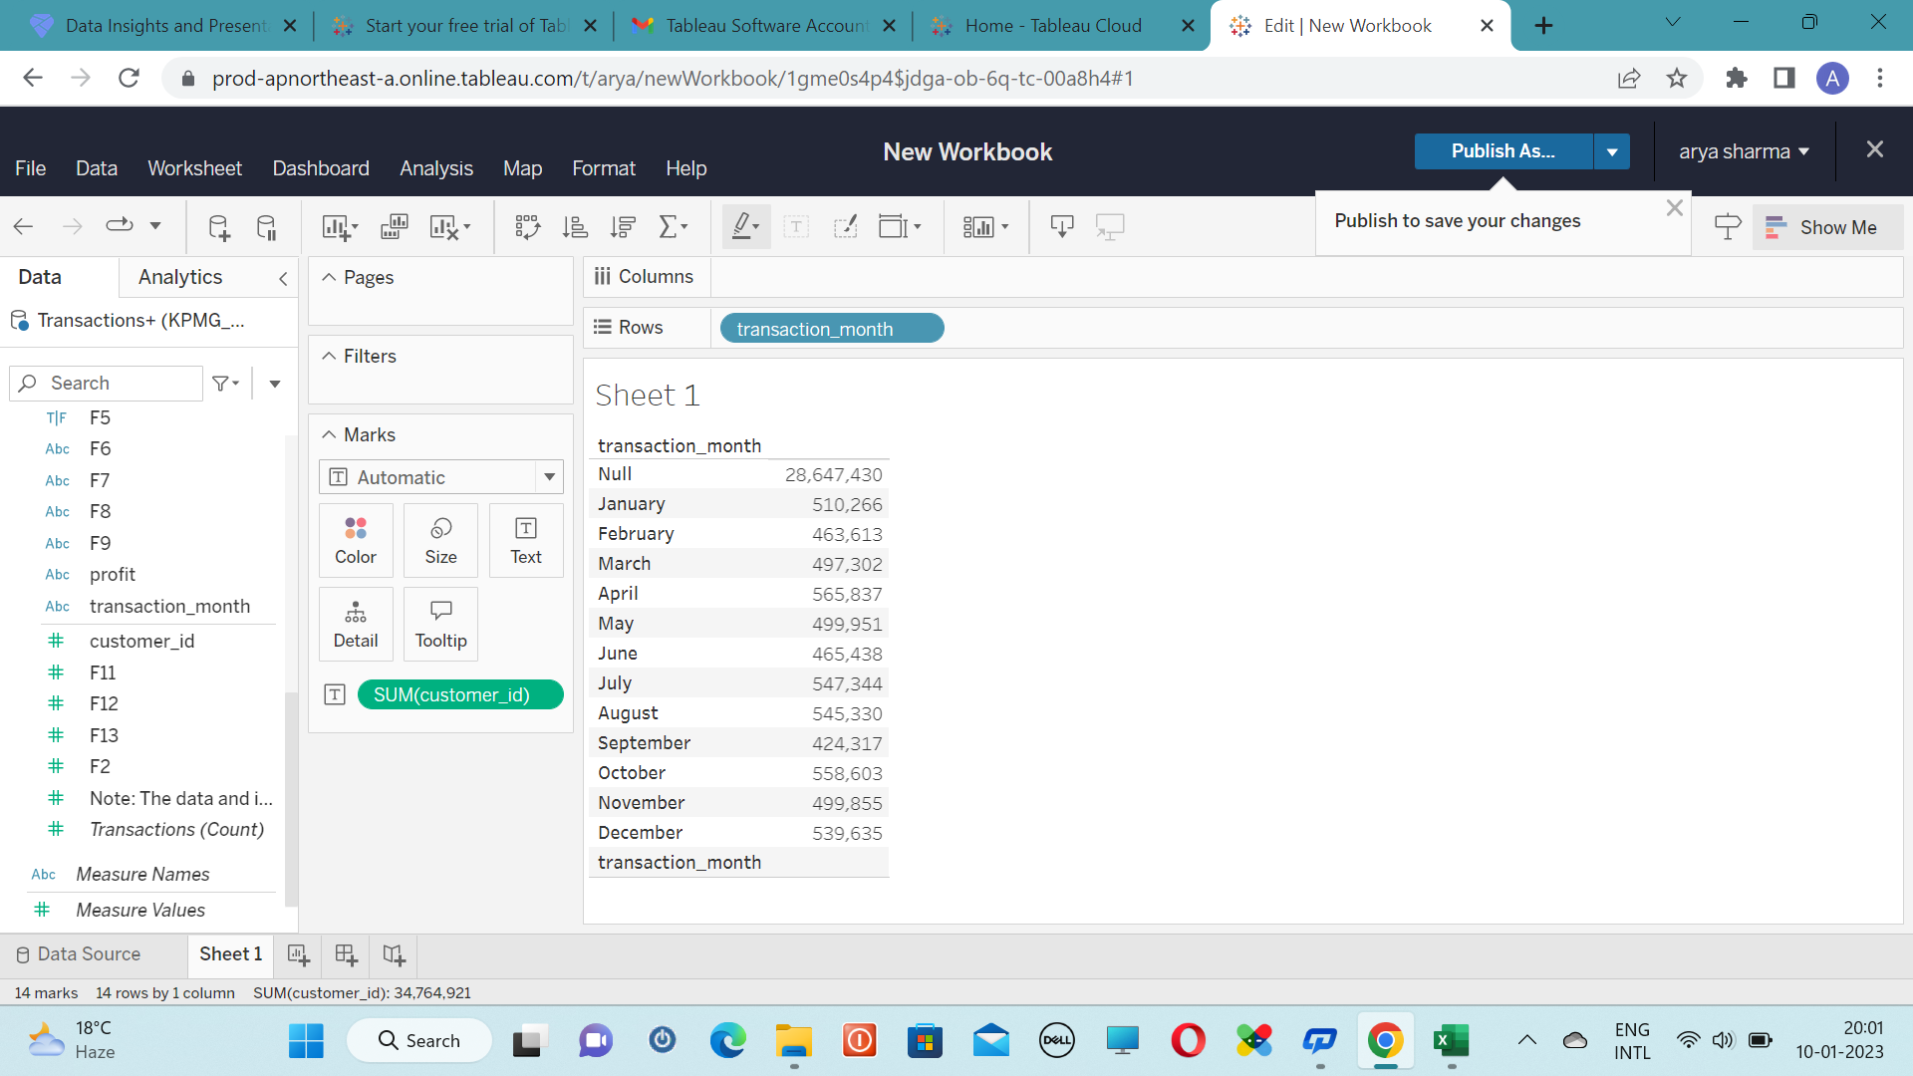
Transaction vs Month

Slide 3
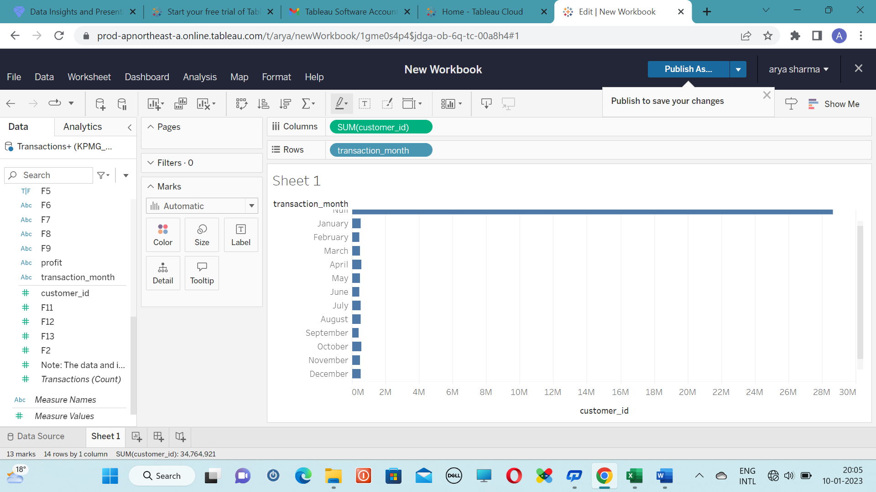

Slide 4
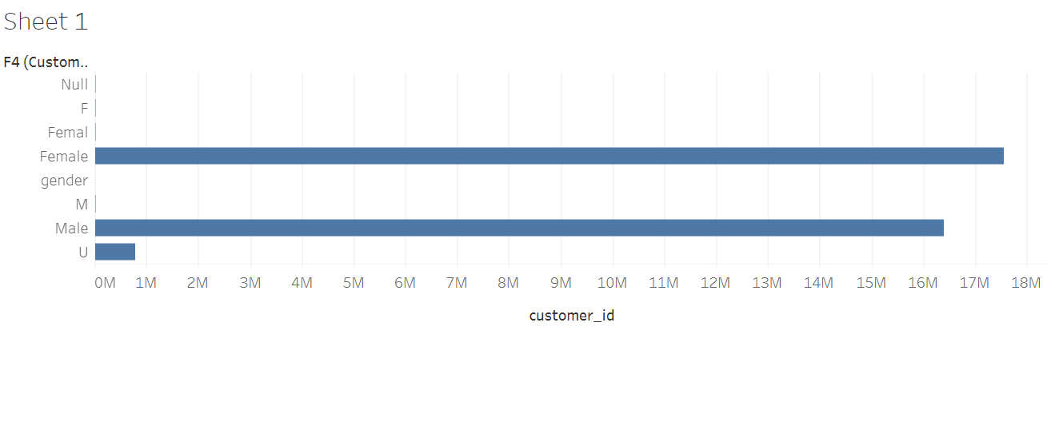
Gender vs Customer_id

Slide 5
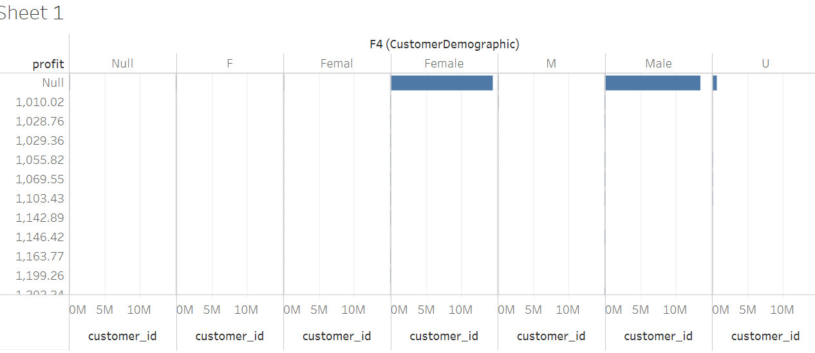


Slide 6
THANK YOU

